Slide 1
AWS Network Security
SYS-360

Slide 2
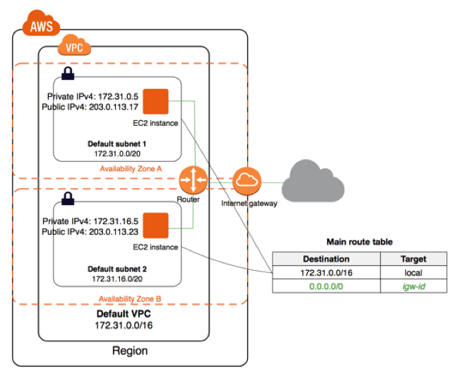
Amazon VPC
Amazon Virtual Private Cloud (Amazon VPC) enables you to launch AWS resources into a virtual network that you've defined.
Amazon VPC is the networking layer for Amazon EC2
The VPC closely resembles a traditional network, with the benefits of using the scalable infrastructure of AWS.

Slide 3
Key Components of VPC
Virtual private cloud (VPC) — A virtual network dedicated to your AWS account.
Subnet — A range of IP addresses in your VPC.
Route table — A set of rules, called routes, that are used to determine where network traffic is directed.
Internet gateway — A gateway that you attach to your VPC to enable communication between resources in your VPC and the internet. Think NAT!

Slide 4
Security Groups
Are an EC2 feature:
We have set these up already, and are connected to Instances
Essentially, a Layer3/4 firewall for an instance
IP addresses and ports
Associated with a VPC
But, assigned to Instances
Similar to host-based firewall - but not configured in O.S.
Security groups are stateful
if you send a request from your instance, the response traffic for that request is allowed regardless of inbound security group rules.

Slide 5
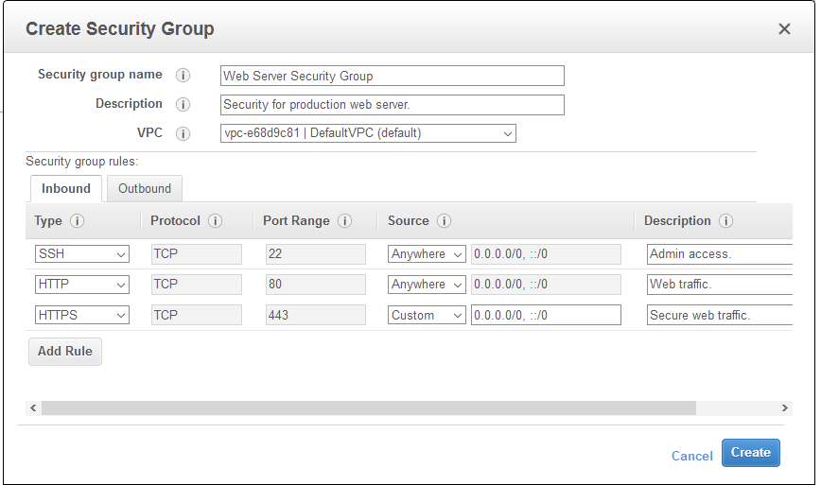
Security Groups

Slide 6
Network ACLs
A network access control list (NACL) is an optional layer of security for your VPC
acts as a firewall for controlling traffic in and out of one or more subnets.
You might set up network ACLs with rules similar to your security groups in order to add an additional layer of security to your VPC. (aka defense-in-depth)
Assigned to subnets, not instances

Slide 7
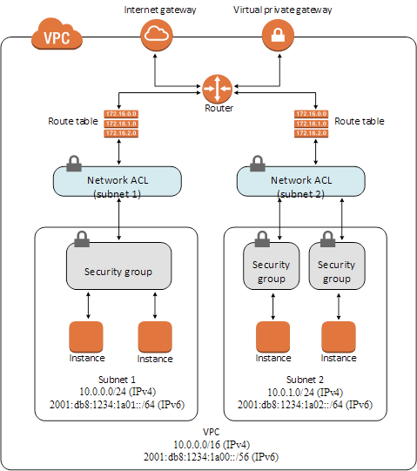
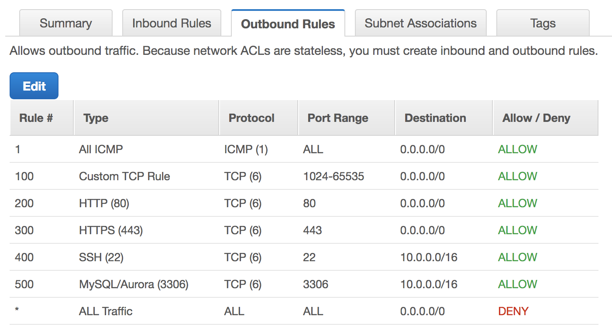
VPC NACL

Slide 8
NACL basics
VPC automatically comes with a modifiable default network ACL.
By default, it allows all inbound and outbound IPv4 traffic
Can create a custom network ACL and associate it with a subnet.
By default, each custom network ACL denies all inbound and outbound traffic until you add rules.
Each subnet in a VPC must be associated with a network ACL.
If subnet not explicitly associated with a network ACL, it is automatically associated with the default network ACL.
Can associate a network ACL with multiple subnets.
However, a subnet can be associated with only one network ACL at a time.
When a subnet is associated with a network ACL, the previous association is removed.

Slide 9
NACL Basics (cont…)
A NACL contains a numbered list of rules.
rules applied in order, starting with the lowest numbered rule
A NACL has separate inbound and outbound rules, and each rule can either allow or deny traffic.
Network ACLs are stateless
This means that responses to allowed inbound traffic are subject to the rules for outbound traffic (and vice versa).
It also means that they are kind of a pain!

Slide 10
NACL Stateless
Port 80 is allowed out
However, responses from a web server will be blocked unless Inbound rule allows traffic to the client!
This is tough when working with ephemeral ports

Slide 11
Configuring NACLs Rules
Rule number. Rules are evaluated starting with the lowest numbered rule. As soon as a rule matches traffic, it's applied regardless of any higher-numbered rule that might contradict it.
Type. The type of traffic; for example, SSH. You can also specify all traffic or a custom range.
Protocol. You can specify any protocol that has a standard protocol number. If you specify ICMP as the protocol, you can specify any or all of the ICMP types and codes.
Port range. The listening port or port range for the traffic. For example, 80 for HTTP traffic.
Source. [Inbound rules only] The source of the traffic (CIDR range).
Destination. [Outbound rules only] The destination for the traffic (CIDR range).
Allow/Deny. Whether to allow or deny the specified traffic.

Slide 12
AWS Network Firewall
Great option!
The AWS Network Firewall is a stateful, managed, network firewall and intrusion detection and prevention service

Slide 13
AWS Firewall Features
stateful firewall:
can incorporate context from traffic flows, like tracking connections and protocol identification
enforce policies such as preventing your VPCs from accessing domains using an unauthorized protocol.
intrusion prevention system (IPS)
provides active traffic flow inspection to identify and block vulnerability exploits using signature-based detection.
web filtering
that can stop traffic to known bad URLs and monitor fully qualified domain names.

Slide 14
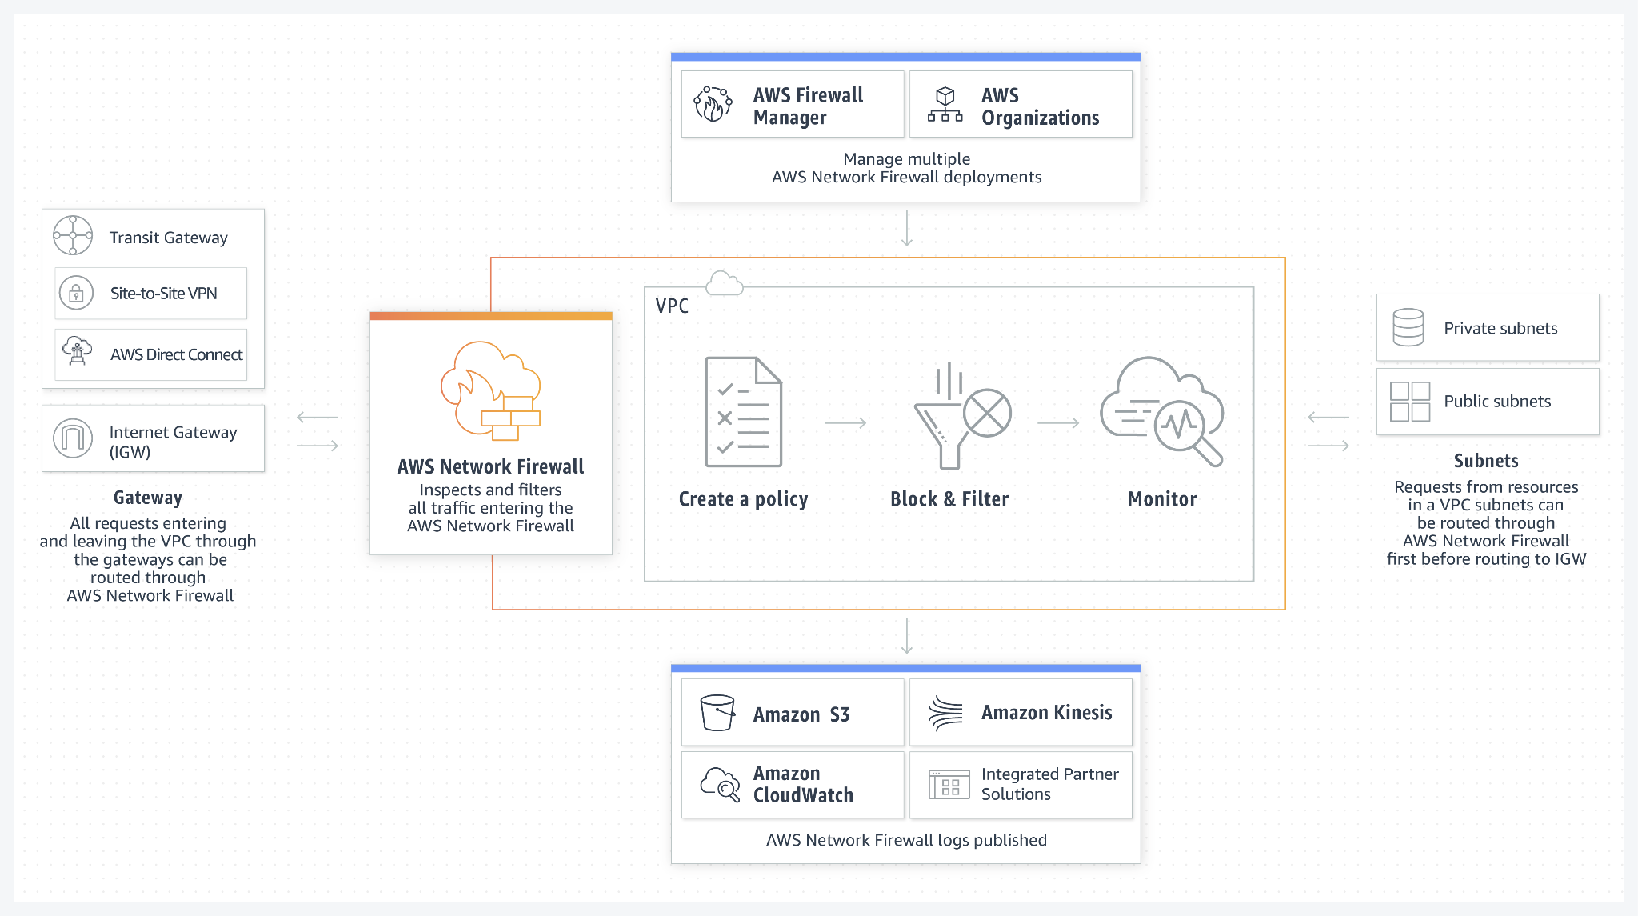

Slide 15
AWS DNS Firewall
New Service (March of 2021)
Filter and regulate outbound DNS traffic for your virtual private cloud (VPC).
Integrated with AWS Route 53 DNS Service

Slide 16
AWS DNS Firewall
A primary use of DNS Firewall protections is to help prevent DNS exfiltration of your data.
DNS exfiltration can happen when a bad actor compromises an application instance and then uses DNS lookup to send data out of the VPC to a domain that they control.
DNS Firewall can deny access to the domains known to be bad
Alternately, can deny access to all domains except for the ones that you explicitly trust.

Slide 17
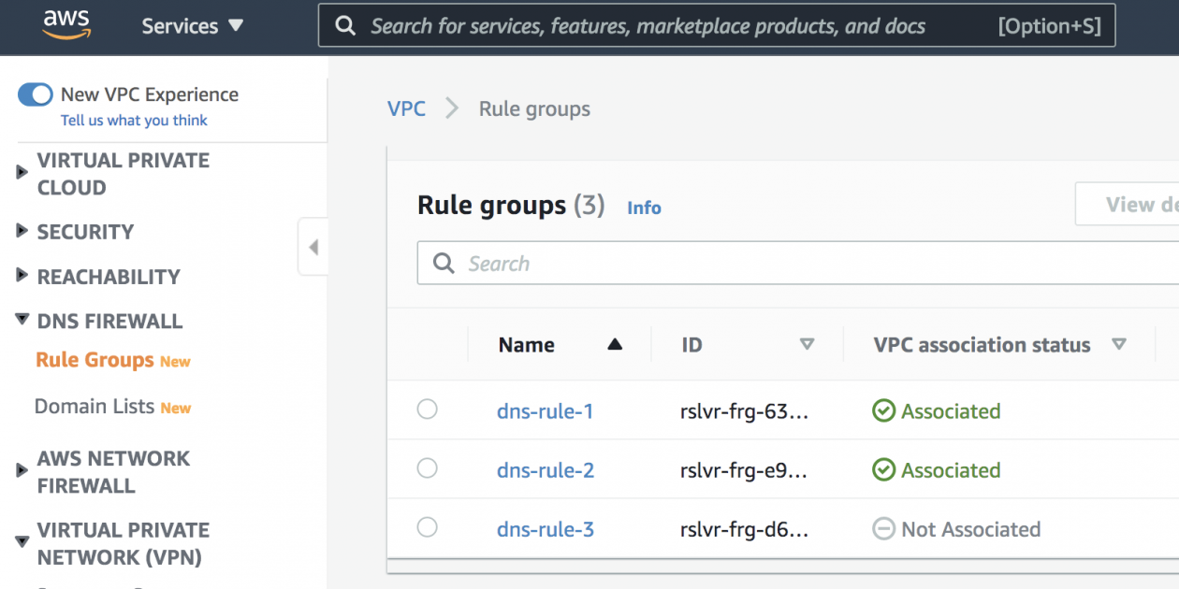
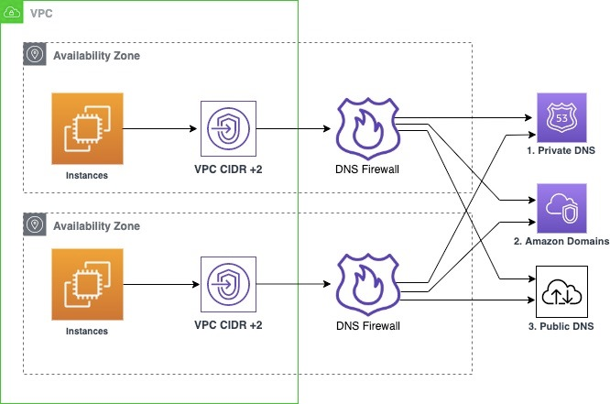
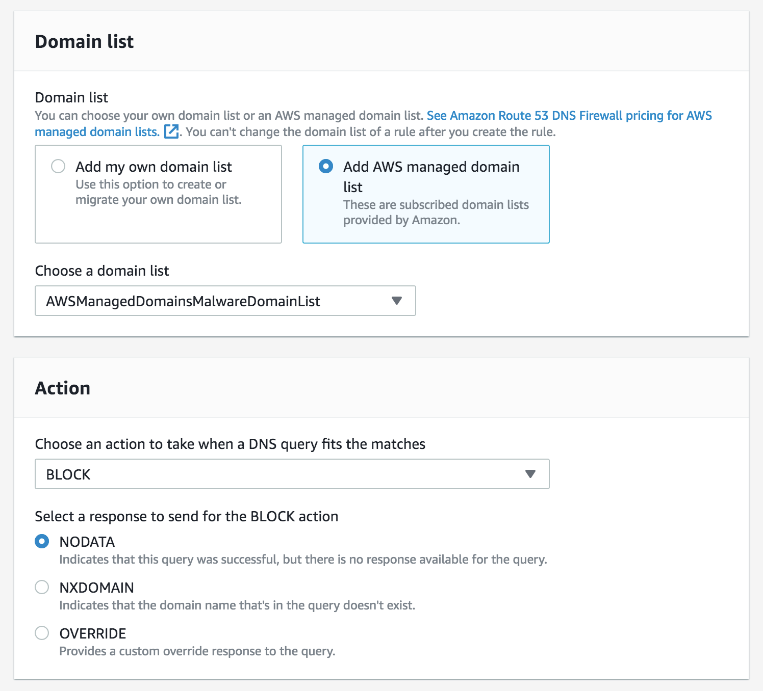
AWS DNS Firewall

